Slide 1
Forensics: Crime Presentation
Kristin Bradford
Jane Delisio
Nhu Hao Tran
Nicholas Hoffmann

Slide 2
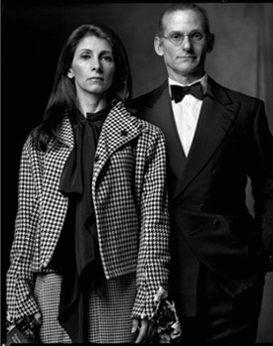
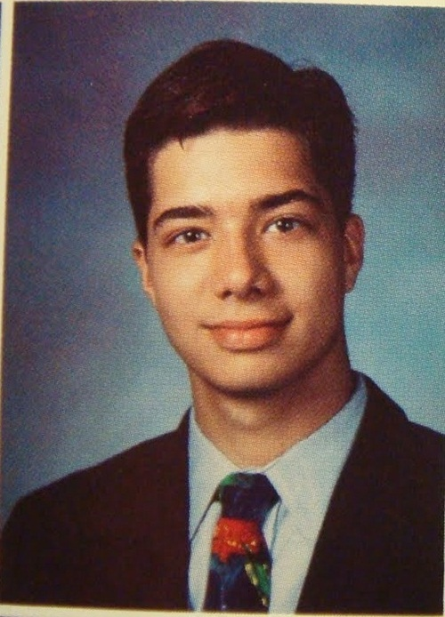
The Family:
Parents: Bob and Julie Adopted Son: Francisco

Slide 3
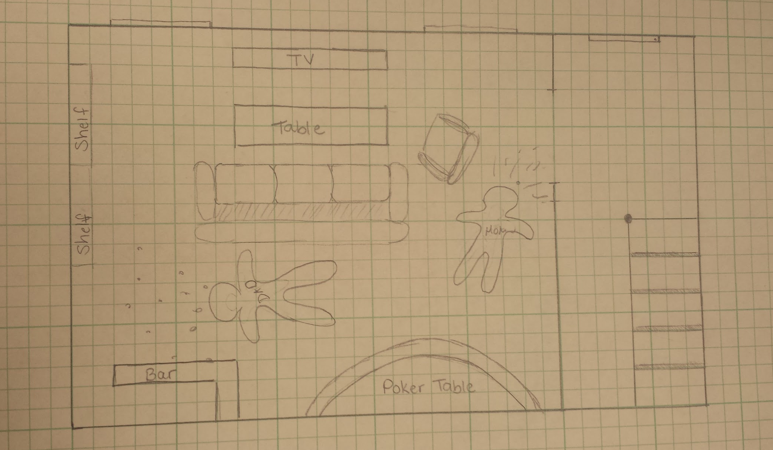
Crime Scene Layout

Slide 4
Crime Scene Police Report
At 2:09 am, police dispatched to home of Bob and Julie Kennedy, a wealthy, well-known Cincinnati family.
At the scene, police find:
Two deceased adults, Bob and Julie, lying on the ground near each other in the living room
Bob has two gun shot wounds to the forehead, a blackened left eye and a bloody nose
Julie has one gun shot wound to the left temple, with blood and skin under her fingernails
Son Francisco is bloodied, but alive, hiding in his upstairs bedroom.
No murder weapon is found, but a gun is found in the family safe
Bob’s blood splatter is behind him, while Julie’s goes up the stairs
Three .22 caliber bullet casings are found

Slide 5
Neighbor Testimony
The next door neighbor stopped by at 6 pm to welcome Bob home from a business trip
The neighbor saw a revolver sitting on the counter
Lots of tension between Bob and Julie
The neighbors woke up at 2am to shouts coming from Bob & Julie’s home
The noise was suddenly interrupted by two consecutive gunshots followed by a third gunshot two minutes later
The same neighbor then looked out the front window and saw a blue Toyota Camry driving slowing past Bob and Julie’s house at 2:05 am
The neighbor remembers seeing the car in Bob and Julie’s driveway before

Slide 6
Francisco's Testimony
He was sleeping before his parents woke him up with fighting about their affairs
The noise was suddenly interrupted by three consecutive gunshots
He was too afraid to leave his room so hid
Told the police the names of Bill and Susan, the people he suspects his parents were having affairs with

Slide 7
Bill’s Testimony
He has had a short lived, recent affair with Julie
She broke it off
Admits to being still love-stricken
Owns a blue Toyota Camry
His fingerprints found all over Julie’s house
Owns a Glockmeister Model G17 9mm pistol; says he was sleeping at time of death

Slide 8
Susan’s Testimony
She has had an on-an-off affair with Bob for the past 18 years
She had just come back home from a trip with Bob, and was tired from traveling, so was she sleeping at time of Bob’s death
A hair from Julie found on a dress in her closet
She owns a Star Model Super B 9mm semi auto pistol

Slide 9
IF ASKED!

Slide 10
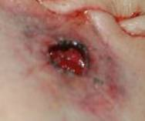
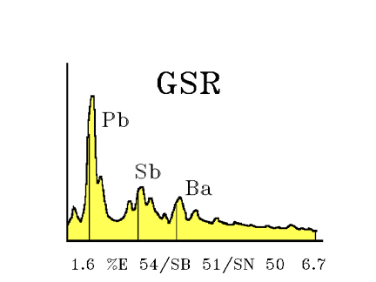
Gun Shot Residue
The following lab results were found positive for GSR on the following people:
Julie’s entrance wound, right hand
Bob’s entrance wounds only
Trace amounts on Francisco’s hand.

Slide 11
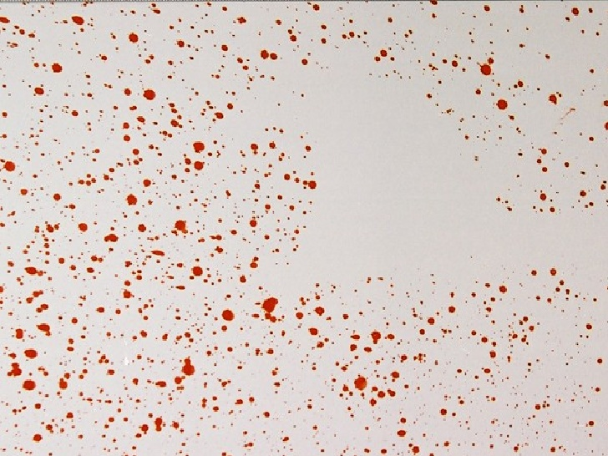
Blood Splatter
-Bob’s blood spatter shows that he was shot point blank, straight on (90 degrees); O+

Slide 12
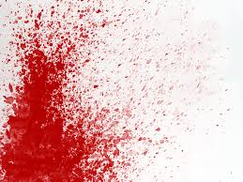
Blood Spatter
Julie’s blood spatter was found on the stairs, with an obvious outline where something blocked spatter.
Through calculation, outline must have been made by a person at least 5’ 11” - 6’ 2” tall
Slight angle of spatter (40-50 degrees); O- blood type

Slide 13
Evidence from Francisco
-Blood spatter on shirt is match to Julie’s: Type O-
-Scratch wound on hands; bruises on fist and red slap-mark on face.
-Francisco stands about 6’ 1” tall

Slide 14
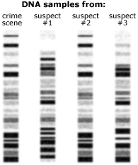
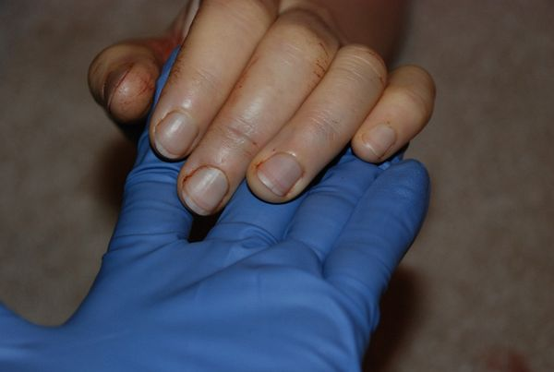
DNA
Fingernail DNA
Bob
Francisco
fBillf
PCR and gel
Swab of Julie’s fingernails revealed skin and blood underneath.

Slide 15
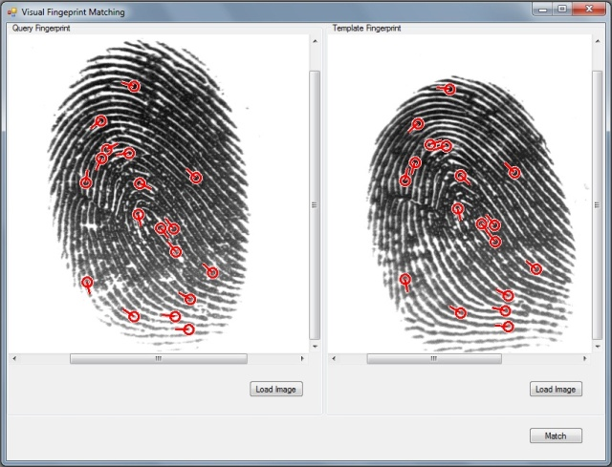
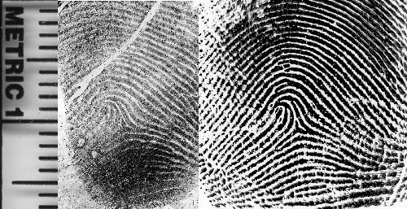
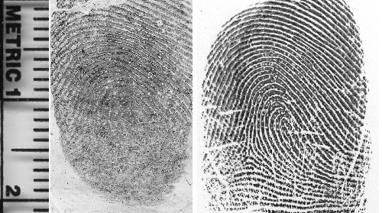
Fingerprints on Gun in Kennedy Safe
Match To
Julie
Match To
Bob
Match To
Francisco

Slide 16
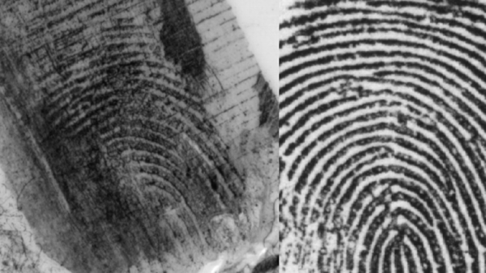
Fingerprints found around house
Most match Bob, Julie, or Francisco
Another set is found:
Matched to
Bill

Slide 17
Blood Types
Julie’s blood type: O⁻
Bob’s blood type: O⁺
Francisco’s blood type: A⁺
Susan’s blood type: A⁺
Bill’s blood type: B⁻

Slide 18
DNA/Adoption
“Adopted” son is actual son of Bob and Susan
DNA confirmation shows that Francisco is not biologically related to Julie, but is biologically related to Bob and Susan

Slide 19
REAL ENDING
What REALLY happened
Bob confronted Julie about her affair
Julie confronted Bob about his affair
Bob told Julie and Francisco about Susan (Francisco’s biological mother from their long-term affair) wanting to meet Francisco and tell him the truth (had been threatening to do it herself if Bob didn’t) to spite Julie
Francisco hit Bob; Julie slapped Francisco; Francisco turned and ran upstairs; Julie grabbed at his hand to stop him, scratching him in the process
After a little more fighting, Julie kills Bob, realizes her terrible mistake and kills herself as Francisco runs back down the stairs after hearing gunshots
Francisco removes gun from Julie’s hand; rubs at hand a bit to remove some residue; places gun in safe; doesn’t want people thinking his mother was crazy

